Slide 1
Data Structures and Algorithms -3 (25CS2103E)
News & Social Media Analytics Engine
Submitted by
K.Mrudula (2520090073)
B.Navya (2520090189)
Under the Esteemed Guidance of
Mrs. Ch. Anitha
Asst. Professor, CS&IT

Slide 2
Contents
Abstract
Introduction
Literature survey
Problem Statement and Objectives
Hardware and Software requirements
Results
Conclusion
Future Scope

Slide 3
Abstract
The News & Social Media Analytics Engine is a powerful system developed to collect, process, and analyze large volumes of data from news websites and social media platforms in real time. With the rapid increase of online content, it has become difficult to manually track trends and public opinions. This project aims to overcome this challenge by using techniques such as data mining and natural language processing.
The system gathers data from various sources, performs preprocessing steps like cleaning and filtering, and analyzes the information to extract meaningful insights. It includes sentiment analysis to classify opinions as positive, negative, or neutral, and identifies trending topics using keyword extraction methods. The results are presented through simple visualizations such as graphs and charts, making the data easy to understand. This system helps users make informed decisions based on current trends and public sentiment.

Slide 4
Introduction
In today’s digital world, a huge amount of information is generated through news websites and social media platforms every day. Analyzing this information manually requires a lot of time and effort. The News & Social Media Analytics Engine provides an automated approach to collect and analyze online content. It uses data mining and NLP techniques to understand the collected text, identify public sentiment, extract important keywords, and find trending topics.

Slide 5
Literature Survey
Existing systems and research approaches have focused on collecting online data, preprocessing textual information, and analyzing public opinions. Natural Language Processing is commonly used to process human-language content, while sentiment analysis helps classify opinions into different categories. Keyword extraction techniques can also be used to identify important topics from large collections of text. Our project combines these approaches to provide an easy-to-understand analytics system.

Slide 6
Problem Statement and Objectives
The rapid growth of news and social media content makes it difficult for users to manually monitor and analyze all available information. The main objective of our project is to automatically collect online data, preprocess and clean the information, analyze the text using NLP techniques, classify sentiment as positive, negative, or neutral, identify important keywords and trending topics, and present the results through simple visualizations.

Slide 7
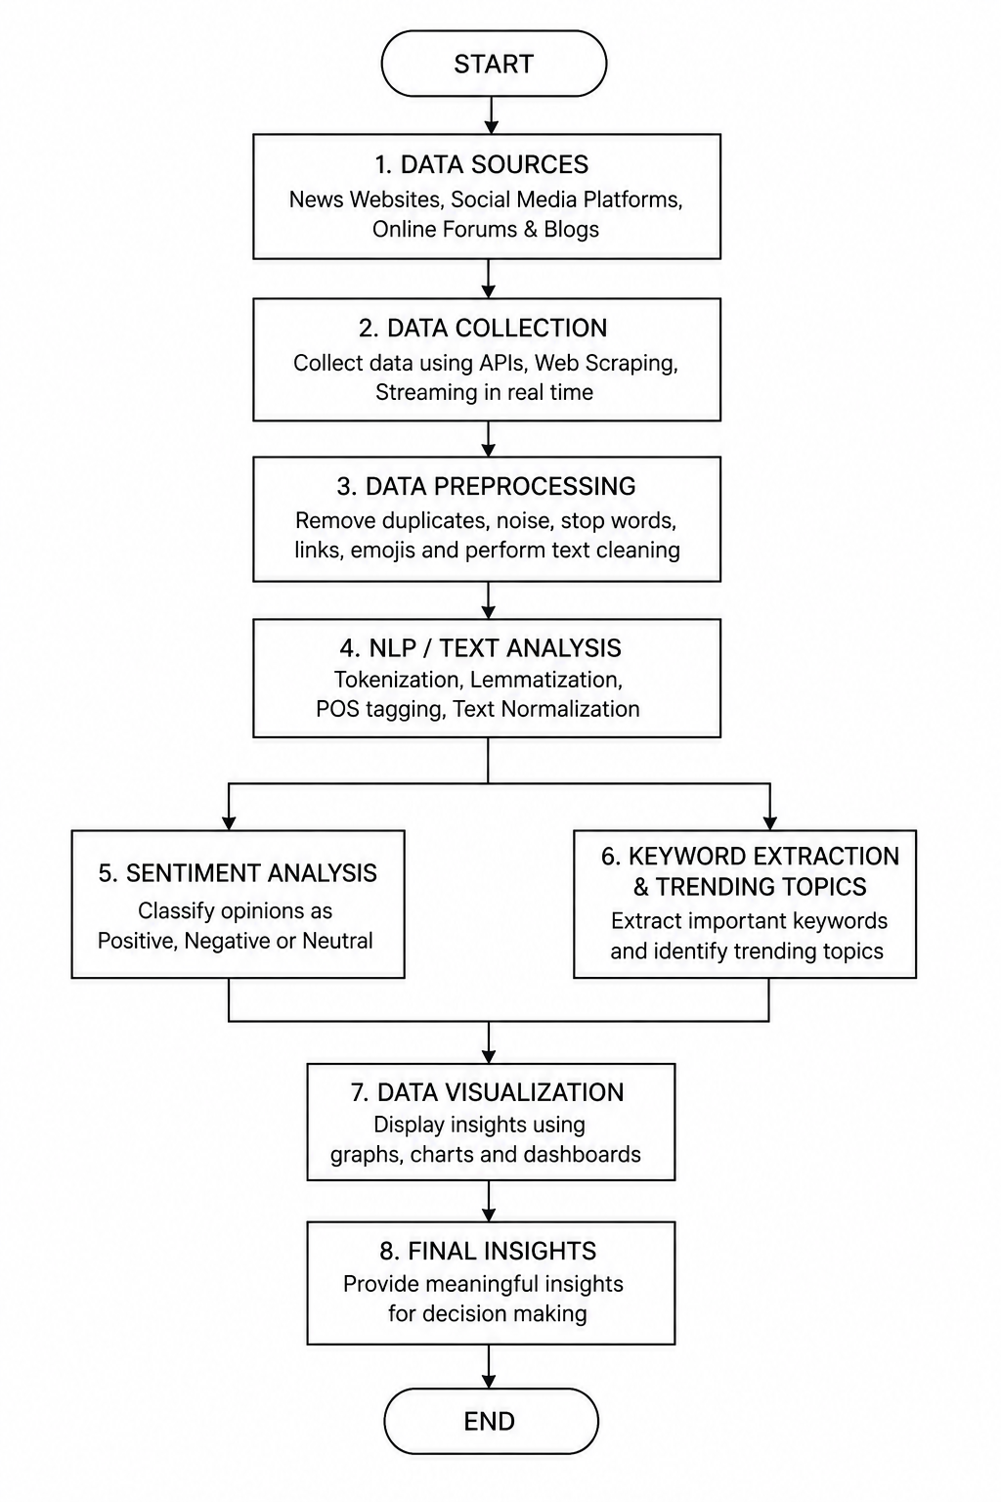
Flow Chart

Slide 8
Results
The system successfully processes the collected online content and extracts meaningful information. It classifies the sentiment of the content into positive, negative, and neutral categories. It also extracts important keywords and identifies trending topics from the analyzed data. The final results are represented using graphs and charts, which makes the information easier to understand and interpret.

Slide 9
Hardware and Software requirements
Hardware Requirements
Hardware Component | Requirement
Computer / Laptop | Suitable system
Processor | Suitable processor
RAM | Sufficient RAM
Storage | Sufficient storage
Internet | Stable internet connection
Software Components
Software Component | Purpose
Programming Environment | Project development
Data Processing Tools | Data cleaning and processing
NLP Tools | Text analysis
Sentiment Analysis | Positive, Negative, Neutral classification
Visualization Tools | Graphs and charts

Slide 10
Conclusion
The News & Social Media Analytics Engine provides an automated way to analyze large volumes of online content. By using data mining and Natural Language Processing techniques, the system can process textual information, identify sentiment, extract keywords, and detect trending topics. The visualization of the results makes the analyzed information simple and understandable for users.

Slide 11
Future Scope
In the future, the system can be enhanced by supporting more news and social media sources and by providing real-time analysis. It can also be extended to support multiple languages and more advanced machine-learning techniques. More detailed dashboards, historical trend analysis, and prediction features can be added to make the system more powerful and useful.

Slide 12
Thank you

